Slide 1
How expensive was your coffee
A predictive analysis of sales in a coffee shop
Alberto Alabau
Marcos Jurach

Slide 2
The starting point and the goal
Over 20.000 sales with at least 30 features each
All data comes from a single month
This analysis focus on predicting the impact on the revenue of management and marketing decisions

Slide 3
How many features can a sale have?
The features chosen were:
Gender
Generation
Time period
Product group
Two approaches on the target variable:
As a continuous distribution
As a categorical variable, with the categories being Cheap, Average and Expensive

Slide 4
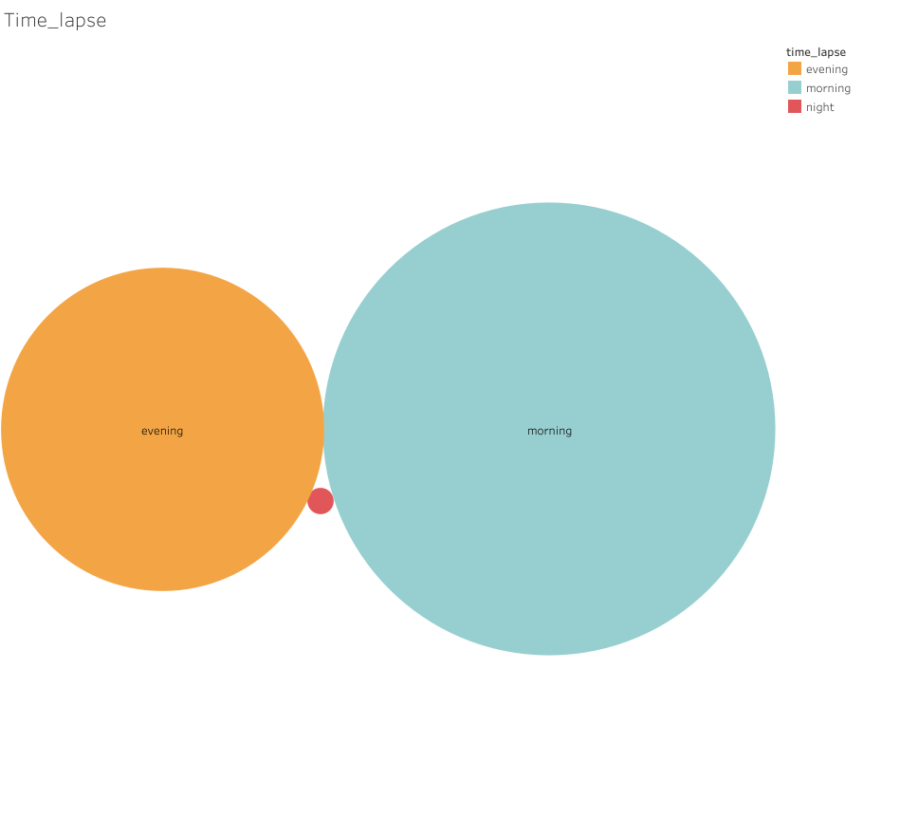
Sales by time period
The number of sales during the night is almost none
Is it profitable been opened during the nights?

Slide 5
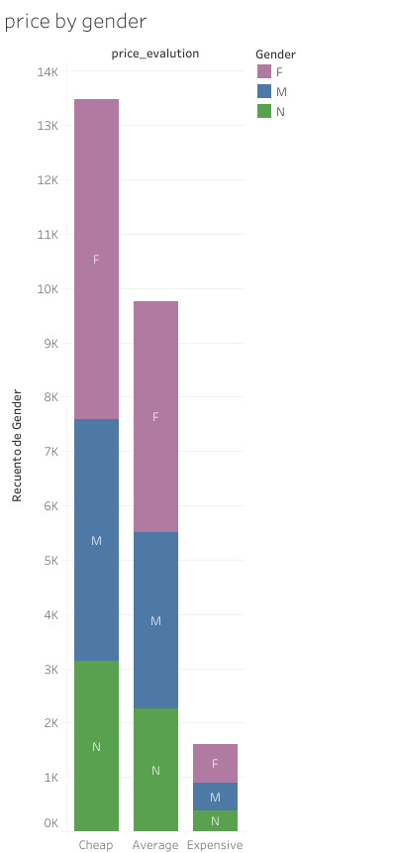
Amount of products by prices and gender
The gender is very proportional between the different price segments
The most popular products are the cheaper ones and the products above 8€ are the less popular.

Slide 6
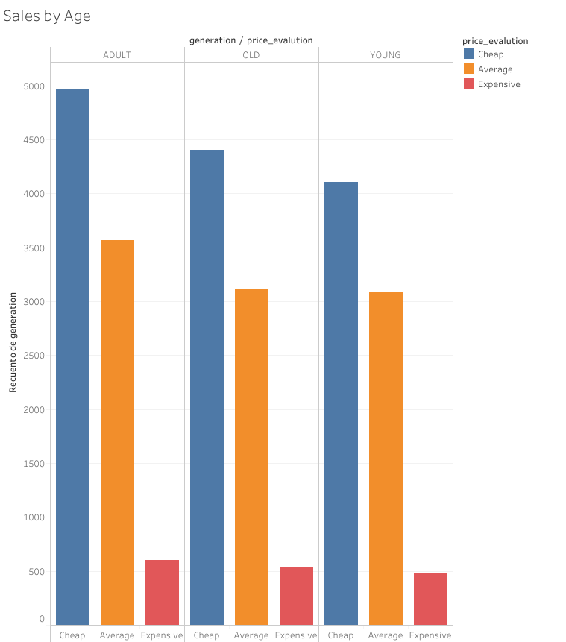
Amount of sales by Age and Price
Few difference in the amount of sales by age.
Total symmetry on the amount of sales by prices

Slide 7
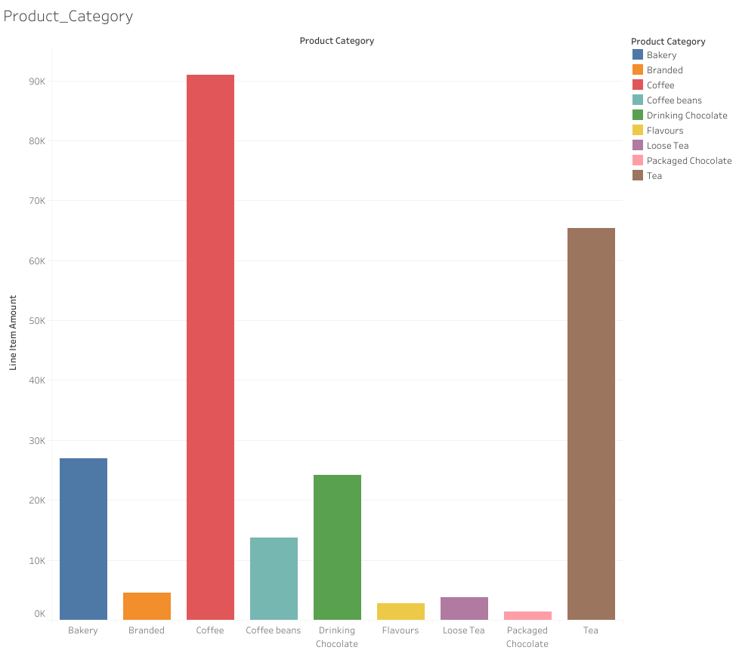
Profit by type of Product
The beverages (coffee and tea) represent a huge proportion of our sales in front of the food and the other products.

Slide 8
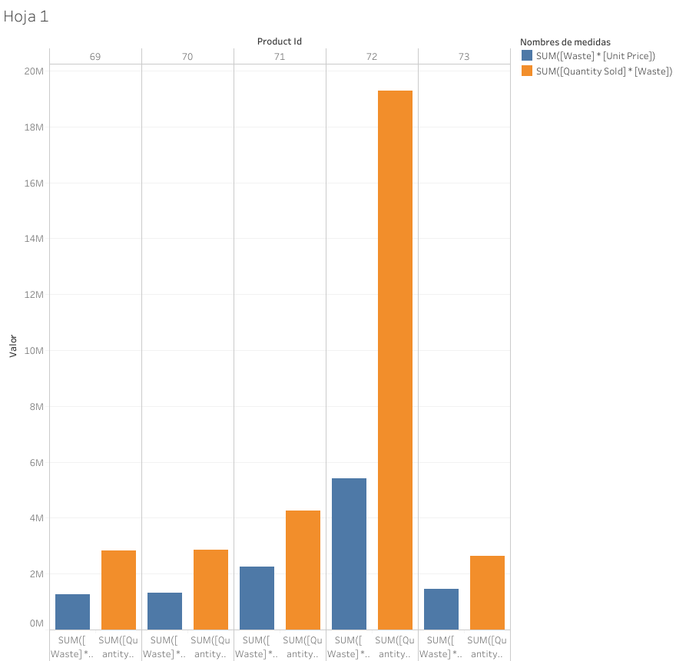
Waste vs Sold
Amount of bakery sold upper the amount of waste

Slide 9

Conclusions from the mangement point of view
The shops are popular in all segments of age and gender.
The beverages are main source of income but the pastry gives also a good revenue.
Night sales should be explored deeper.

Slide 10
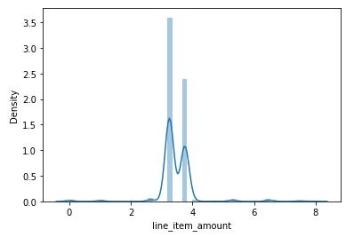
Sales as a continuous distribution
The model that performed the best was the Linear Regression!
Sadly this doesn’t mean the model is good.
R² on the test set: 0.395
This can be justified by the fact that the feature
is not actually continuous, since it’s a sum of item prices.

Slide 11
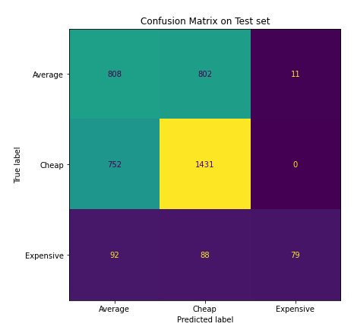
Sales as a categorical variable
The models, in general, perform better, with the Decision Tree
performing the best with the score of 0.57.
The best part about the model is that it doesn’t predict high value
sales that are actually low and mid value.
This comes at the cost of the precision of the sale price.

Slide 12
Where are we and where are we going
The data collection is going great!
Creating a reliable model to predict revenue is pretty difficult with the amount of data up until now.
The useful model we got is enough to justify some decision on the management and marketing team, but the prediction will be more in a abroad direction instead of a specific revenue.

